Slide 1


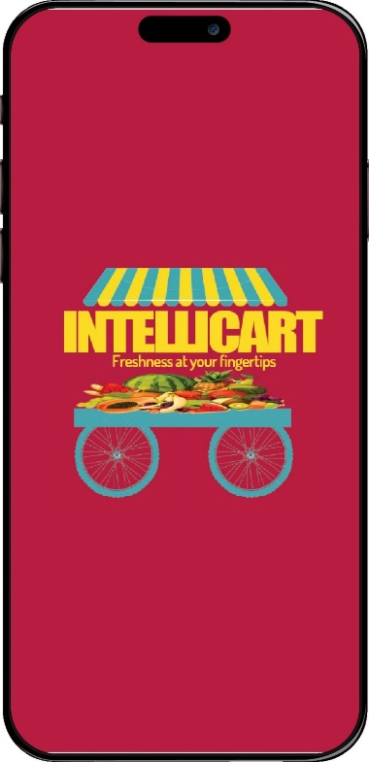

IntelliCART
(Intelligent RehriWala)
“Transforming Roadside Fruit Vendors with AI-Powered Fruit Classification and Customer Convenience”
Department of Computer Science, FAST-NUCES, Karachi, Pakistan
FYP1-EVALUATION

Slide 2
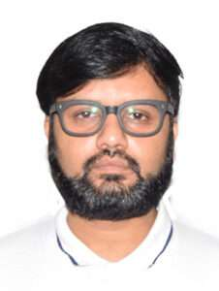
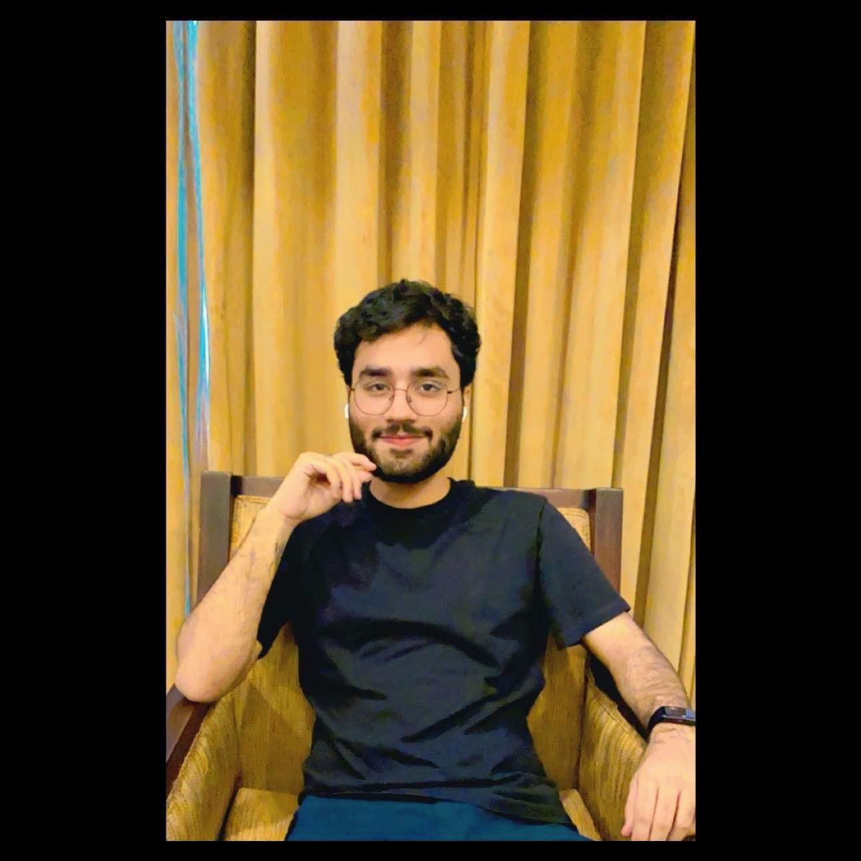
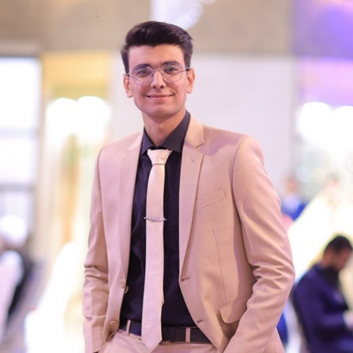
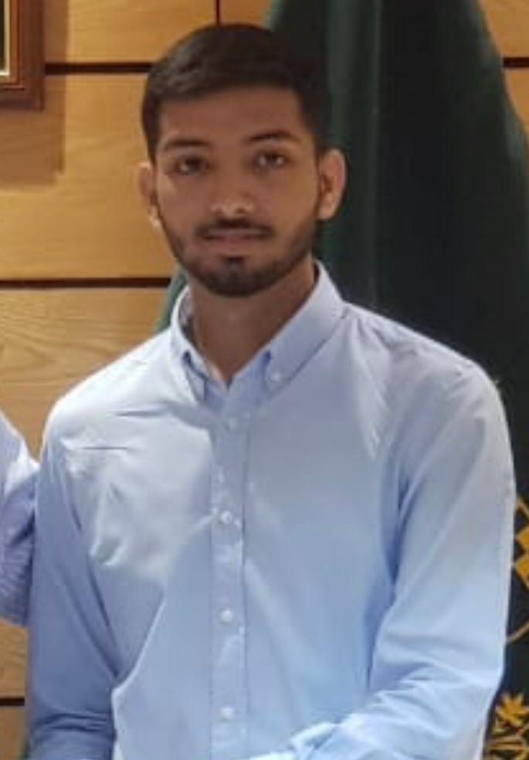
Project Team
Project Supervisor
Dr. Muhammad Farrukh Shahid
Project Members
Abdul Ahad Shaikh
20K-0477
Mohammad Basil Ali Khan
20K-0477
Syed Jodat Ali Naqvi
20K-0155

Slide 3
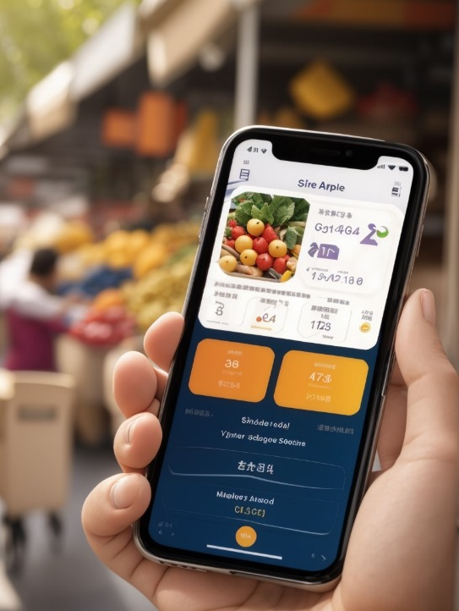
Agenda
Introduction
Problem Statement
Objectives
Current Scenario vs Proposed Scenario
How to achieve goals
Work Contribution
Literature Review
Methodology
Dataset
Dataset Collection Drive
Work Timeline
Budget
References

Slide 4
Introduction
Welcome To The Future Of Urban Fruit’s And Vegs Supply Chain Solution.
This Project Aims To Revolutionize The Vegetables And Fruits Retail Market, Especially The Roadside Vendors. Harnessing The Power Of AI, This Project Will Enable Customers To Identify Fresh Fruits And Vegs Just From Their Cell Phones And Locate Their Required Fruit.
Upgrading These Rehris Would Provide Convenience To Both Customers And Sellers Through Smooth Retail, Also Reducing Traffic Congestions.

Slide 5
Problem Statement
Fruit vending market is quite unmanaged, neither the prices are controlled by government nor the quality, thus customers face difficulty in finding and classifying healthy fruits, leading to compromised choices. This sector even lacks the proper infrastructure to facilitate customers. Considering these we are stepping up to solve these issues leveraging the power of AI.

Slide 6
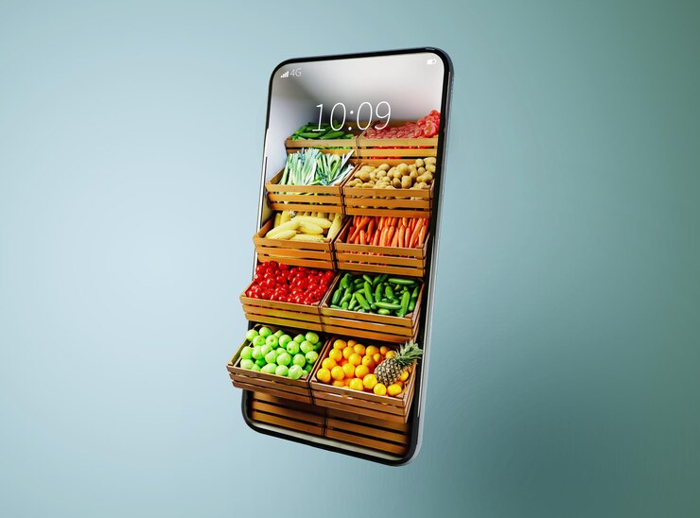
Objectives
Objective 1:
To classify fruits and vegetable based on their quality through image analysis of their characteristics using Computer Vision and Deep Learning.
Objective 2:
To support local vendors by providing them with an increased market reach.
Objective 3:
To provide real time fruit quality monitoring.
Objective 4:
To avoid roadside congestions caused due to roadside fruit carts.
Objective 5:
To provide platform to customers where they can buy fresh fruits hassle free.
Objective 6:
To let customers compare current government prices with vendor’s fruit prices.
Objective 7:
Enabling customers to locate the fruits they want.
Objective 8:
In future, enabling fruit carts to be fully autonomous, allowing them to deliver fruits, move taking care of traffic, alerting for low-quality fruits, determining quality wise fruit prices and fully controlled.

Slide 7
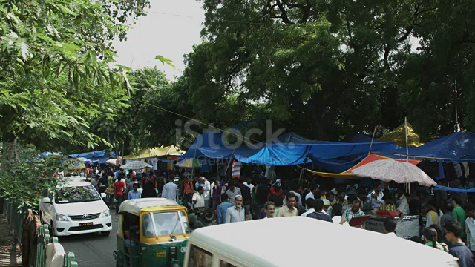
Current Scenario

Slide 8
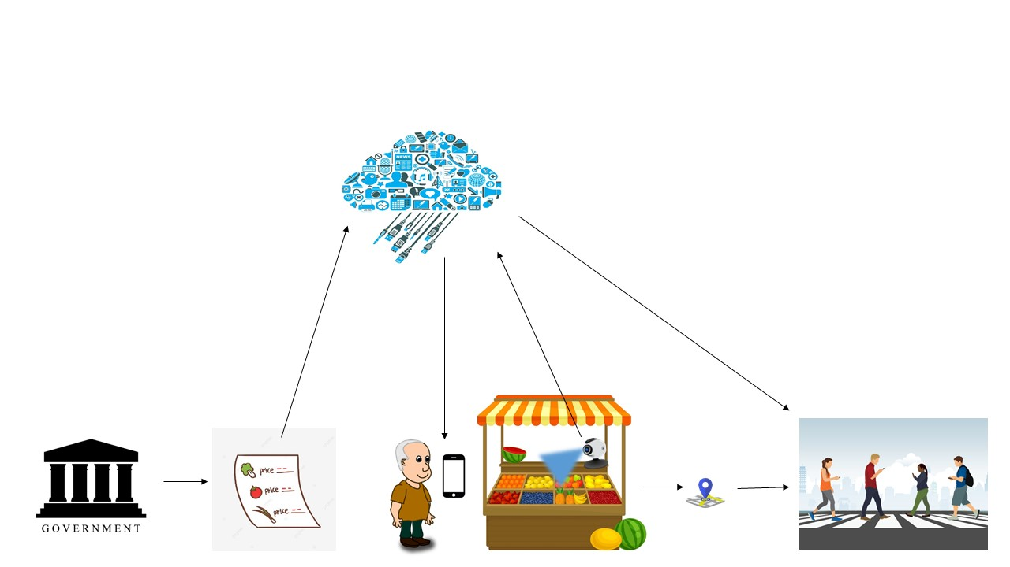
Proposed Scenario
Cloud Storage
IntelliCart
Government department that releases daily fruits and vegetable price list.
Customers
Global Position Service
Fruits / Vegetables Price List
Seller

Slide 9
Achieving Goals
Problems | How IntelliCART solves
Classify Fruits and Vegetables | CNN models
Increased market reach for vendors | Application for customers and sellers
Real time fruit quality assessment | Computer Vision using Camera on Cart
Road congestion due to roadside vendors | Making well-informed purchasing decisions through the app, which have already been pre-determined.
Uncontrolled fruits’ prices | Integrating government price API with App for customers
Locating required fruits and vegetables | Tracking each registered vendor and their fruit stock

Slide 10
5G Use Cases
Enhanced Real-Time Data Transmission:
Leveraging the high-speed and low-latency capabilities of 5G networks, the fruit cart's camera data can be transmitted in real time to the mobile application. This ensures that customers receive instant and updated information about the freshness of fruits and vegetables.
Edge Computing for Rapid Processing:
5G's support for edge computing can facilitate rapid processing of data collected by the fruit cart's camera. This allows for quick analysis of the produce's freshness and ensures minimal delays in providing accurate information to customers.
Seamless Connectivity for GPS Integration:
5G networks' robust connectivity will enable seamless integration of GPS technology, ensuring that customers can easily locate nearby fruit carts without experiencing delays or connection issues.
Remote Monitoring and Management:
With 5G's high-speed connectivity and reliability, the fruit cart system can be remotely monitored and managed. This feature allows for efficient troubleshooting, software updates, and real-time adjustments, enhancing overall system performance and customer satisfaction.

Slide 11
Work contribution to Society
Enhancing Food Quality and Safety: The Smart Cart uses computer vision technology to assess the freshness of fruits and vegetables in real-time, helping ensure that customers receive high-quality and safe produce. This can reduce the risk of foodborne illnesses and improve overall public health.
Fair Pricing: The system's price verification capabilities help ensure that customers are charged fair prices for the fruits and vegetables they purchase. This prevents overcharging and promotes ethical business practices among fruit cart vendors.
Economic Opportunities: The Smart Cart can potentially expand the customer base for fruit cart vendors, leading to increased income and economic opportunities for these small-scale entrepreneurs. It can also help them build better relationships with their customers.
Technology Integration: The Smart Cart integrates various technologies such as mobile applications, cloud computing, and GPS. This integration not only improves the efficiency of the fruit cart operation but also provides an example of how technology can be harnessed for the benefit of society.

Slide 12
Literature Review
Published in year | Classes | Method | Features | Classifiers | Reference
IRJET 2021 | Apple, banana, Mango Disease | K-means clustering technique to cluster the images | color, morphology, Color Coherence Vector (CCV) | Support Vector Machine (SVM). | [6]
ICIRCA 2020 | Banana disease | classifying the diseases in the banana plant at the earlier stage to prevent the nearby plants from the same diseases. | Feature extraction classification is mainly based on the pattern recognition | Artificial Neural Network (ANN) | [7]
Springer 2015 | Apple diseases blotch, rot and scab | Threshold approach is used for segmentation. k-means clustering | Texture, shape and color features. | multi-class support vector machine | [1]
IJSR 2015 | Leaf or Fruit and fruit images | Otsu’ method, k-means clustering | Color Coherence Vector, Complete Local Binary Pattern and Local Binary Pattern , Color Histogram | Artificial Neural Network, Support Vector Machine (SVM) | [2]

Slide 13
Literature Review (…Contd)
Published in year | classes | Method | Features | Classifiers | Reference
IRJET 2015 | Apple scrub, apple bitter rot | image segmentation RGB to gray conversion median filter, edge detector, and morphology operation | Texture, shape and color features. | support vector machine | [3]
IJCSIT 2015 | Pomegranate disease detection | Intent searching with k mean clustering | Color, Morphology and Texture | K-nearest neighbor algorithm | [4]
IEEE 2012 | Apple plant disease | Local binary pattern with SVM | Color Coherence Vector, Global Color Histogram , Complete Local Binary Pattern and Local Binary Pattern | Support Vector Machine (SVM). | [5]

Slide 14
Literature Review (…Contd)
Application Startup Name | Features
 | Fruit / Vegetable Price | Comparison with government prices | Freshness monitoring through Computer Vision | Nearby Cart location | Home delivery | Boxes based on dietary preferences | Have Website | Have Application
IntelliCart (Our Project) | ✓ | ✓ | ✓ | ✓ | ✗ | ✗ | ✗ | ✓
FruitSabzi | ✓ | ✗ | ✗ | ✗ | ✓ | ✗ | ✓ | ✗
Farmette | ✓ | ✗ | ✗ | ✗ | ✓ | ✗ | ✓ | ✗
F2H- Farm to Home | ✓ | ✗ | ✗ | ✗ | ✓ | ✗ | ✓ | ✗
FreshSabz | ✓ | ✗ | ✗ | ✗ | ✓ | ✗ | ✓ | ✓
Subzi.pk | ✓ | ✗ | ✗ | ✗ | ✓ | ✓ | ✓ | ✗
Application Startup Name | Features
 | Fruit / Vegetable Price | Comparison with government prices | Freshness monitoring through Computer Vision | Nearby Cart location | Home delivery | Boxes based on dietary preferences | Have Website | Have Application
IntelliCart (Our Project) | ✓ | ✓ | ✓ | ✓ | ✗ | ✗ | ✗ | ✓
FruitSabzi | ✓ | ✗ | ✗ | ✗ | ✓ | ✗ | ✓ | ✗
Farmette | ✓ | ✗ | ✗ | ✗ | ✓ | ✗ | ✓ | ✗
F2H- Farm to Home | ✓ | ✗ | ✗ | ✗ | ✓ | ✗ | ✓ | ✗
FreshSabz | ✓ | ✗ | ✗ | ✗ | ✓ | ✗ | ✓ | ✓
Subzi.pk | ✓ | ✗ | ✗ | ✗ | ✓ | ✓ | ✓ | ✗

Slide 15
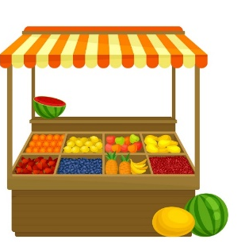
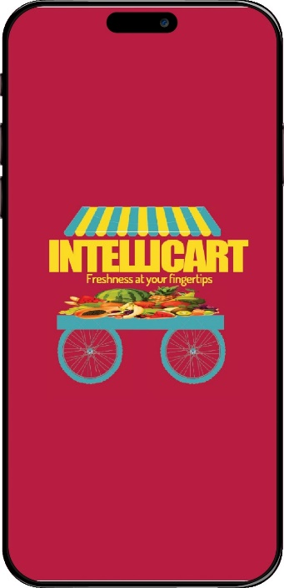
Methodology
Dataset
Feature Extraction
(Obtaining Scalograms)
Deep Learning Models
Trained Models
Training
Testing
Train Set
Testing Processing
Trained Models
Model Performance Evaluation
Classification
Test Set
Testing Processing
Fig 1 Block Diagram of the proposed methodology

Slide 16
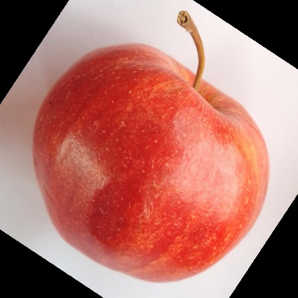
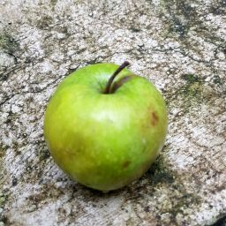
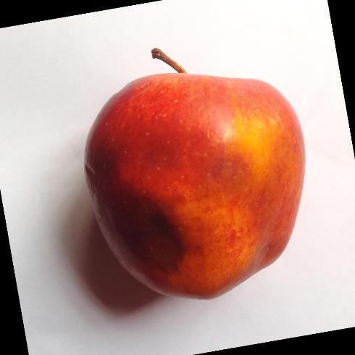
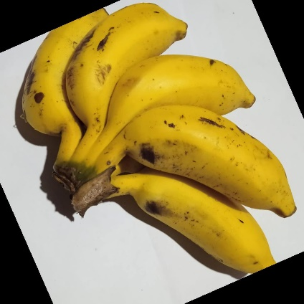
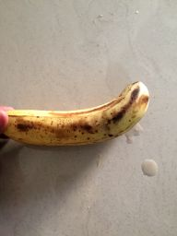
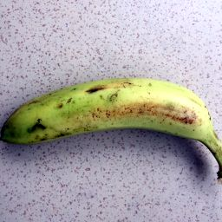
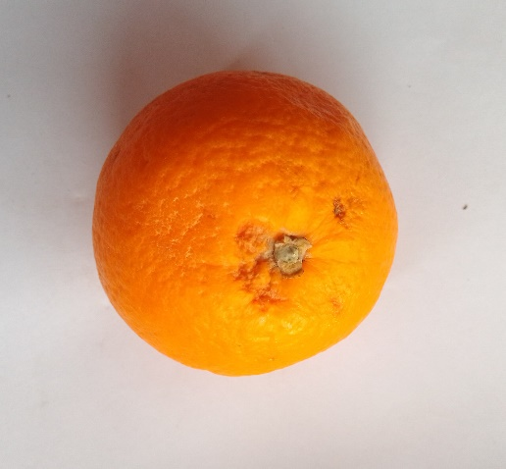
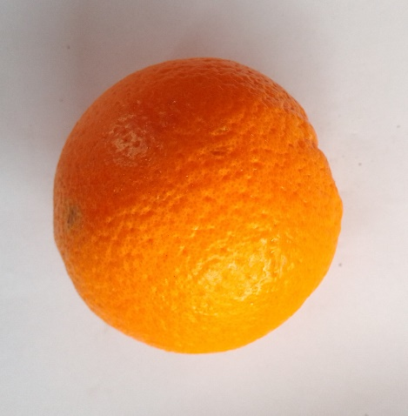
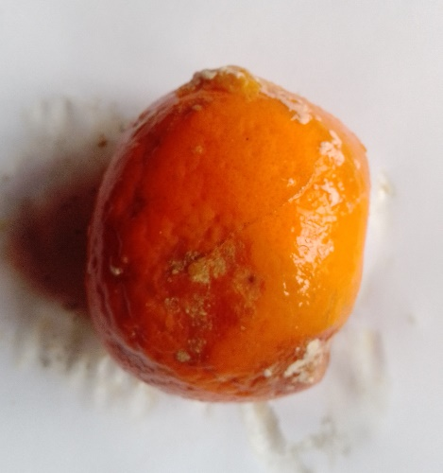
Dataset
Fruits | Dataset
Apple
Banana
Oranges

Slide 17
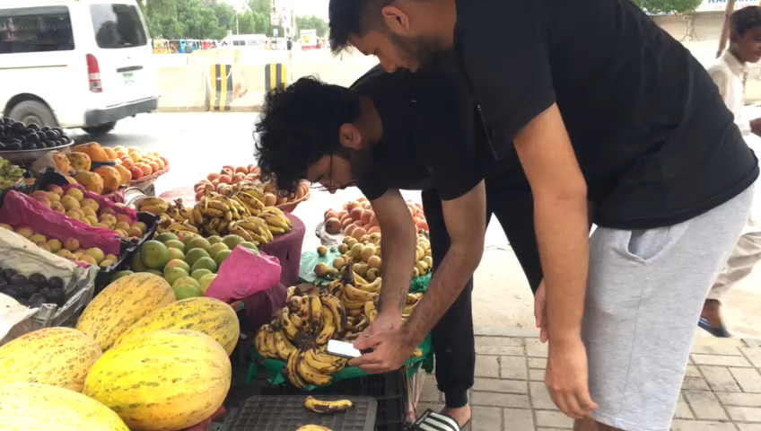
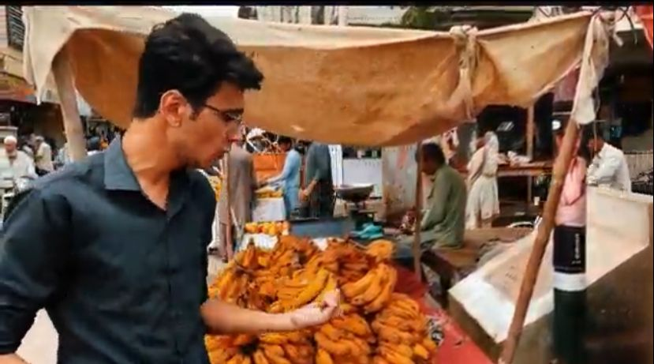
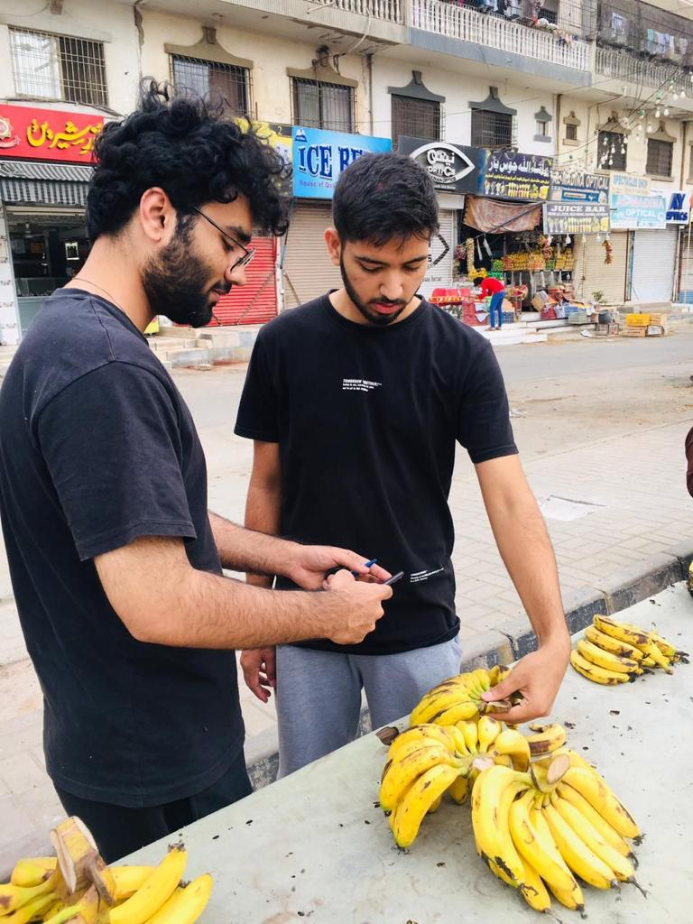
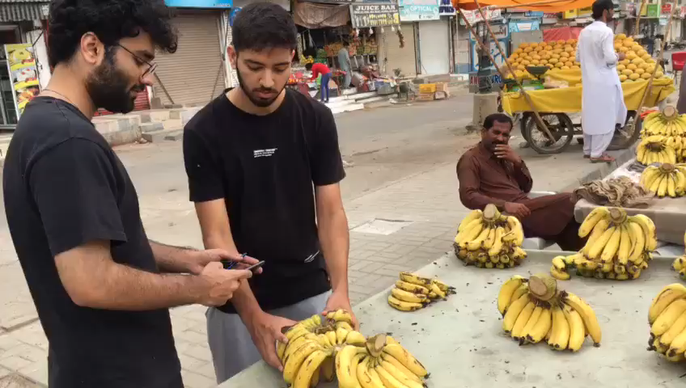
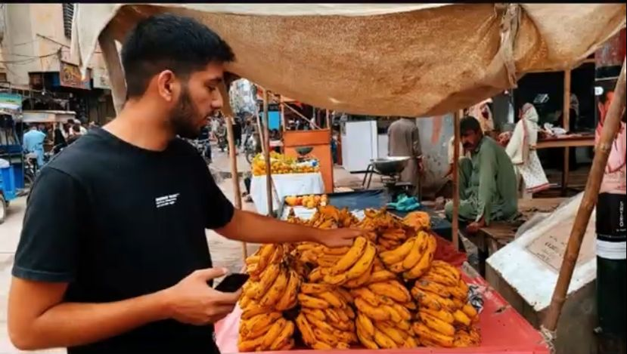
Dataset Collection Drive

Slide 18
Proof Of Concept
Components
Mobile Application
Camera Integration
Key Steps
Image Capture and Analysis
Government Price Integration
Outcome
Real Time Freshness Assessment
Nearby Cart Location
Cloud Based Backend
Dataset
GPS based Cart
Government Price Validation
CNN Models
Conclusion
Commitment to transparency, trust, and health in the fresh produce market.

Slide 19
Work Timeline
Timeline | Phases | Team Roles
Month 1 | Literature Review | Ahad, Jodat
Discussing the progress with Dr. Muhammad Farrukh Shahid (PI)
Month 2 | Data Collection | Ahad, Basil, Jodat, Dr. Farrukh
Discussing the progress with Dr. Muhammad Farrukh Shahid (PI)
Month 3 | Feature Extraction | Ahad, Basil
Discussing the progress with Dr. Muhammad Farrukh Shahid (PI)
Month 4 | Deep Learning Model | Ahad, Jodat, Basil
Discussing the progress with Dr. Muhammad Farrukh Shahid (PI)
Month 5 | Model Testing and Optimization | Jodat, Ahad
Discussing the progress with Dr. Muhammad Farrukh Shahid (PI)
Month 6 | Cloud Integration | Basil, Jodat
Discussing the progress with Dr. Muhammad Farrukh Shahid (PI)
Month 7 - 8 | Mobile App Design and Development | Ahad, Basil, Jodat
Discussing the progress with Dr. Muhammad Farrukh Shahid (PI)
Month 9 - 10 | System Integration | Jodat
Discussing the progress with Dr. Muhammad Farrukh Shahid (PI)
Month 11 | Evaluation and Testing | Ahad
Discussing the progress with Dr. Muhammad Farrukh Shahid (PI)
Month 12 | Documentation and Reporting | Basil, Jodat
Submitting Final Report

Slide 20
Budget
Item | Category | Budget | Total
Cloud Services (AWS/AZURE) | Computer Services and Consultants | $10,000 | $10,000
EQUIPMENTS MAJOR (>100,000) Laptop/Mac, 2 Tensor GPU and CPU for Deep Learning (M2 Mac Studio 32GB RAM 512 GB SSD) | D-equip and Material | $15,000 | $25,000
EQUIPMENTS MINOR (>10,000) Camera, Arduino, Rasberry-Pi, GPS tracker, Wiring, Wi-Fi Dongle | D-equip and Material | $1000 | $26,000
Internet Usage | Computer Services and Consultants | $500 | $26,500
Paperwork | D-equip and Material | $100 | $26,600
Dataset Drives(Fuel cost) | Operating Expense | $1000 | $27,600

Slide 21
References
[1] Shiv Ram Dubey1 · Anand Singh Jalal2 "Apple disease classification using color, texture and shape features from images Signal”, Image and Video ProcessingDOI 10.1007/s11760-015-0821-1
[2] Zalak R. Barot, Narendrasinh Limbad "An Approach for Detection and Classification of Fruit Disease:A Survey" Volume 4 Issue 12, December 2015..
[3]Swati Dewliya Ms. Pratibha Singh Detection and classification for apple fruit diseases using support vector machine and chain code Volume: 02 Issue: 04- Aug-2015
[4] Manisha A. Bhange, Prof. H. A. Hingoliwala“A Review of Image Processing for Pomegranate Disease Detection” IJCSIT] International Journal of Computer Science and Information Technologies, Vol. 6 [1 ], 2015.
[5] ]Shiv Ram Dubey, Anand Singh Jalal “Detection and Classification of Apple Fruit Diseases using Complete Local Binary Patterns” proceeding of third IEEE International Conference 2012.
[6] Dr. Praveen Kumar Reddy, Md. Manzoor Hussain, Shravan Kumar “Fruit Disease Detection and Identification using Image Processing” e-ISSN: 2395-0056
[7] N. Saranya, L. Pavithra, N. Kanthimathi, B. Ragavi and P. Sandhiyadevi, "Detection of Banana Leaf and Fruit Diseases Using Neural Networks," 2020 Second International Conference on Inventive Research in Computing Applications (ICIRCA), 2020, pp. 493-499, doi: 10.1109/ICIRCA48905.2020.9183006.

Slide 22


